Slide 1
Inflation Report August 2019
Global developments and domestic financial conditions

Slide 2
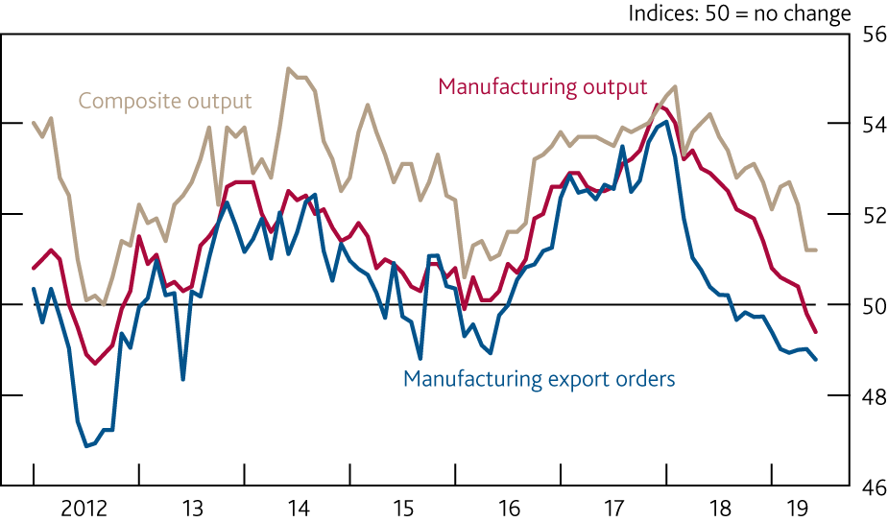
Chart 1.1 Survey indicators of global output growth have fallen, particularly in the manufacturing sector
Global purchasing managers’ indices^{(a)}
Sources: Eikon from Refinitiv, IHS Markit and JPMorgan.
(a) Measures of current monthly composite (services and manufacturing) output, manufacturing output, and manufacturing export orders growth based on the results of surveys in 44 countries. Together these countries account for an estimated 89% of global GDP.

Slide 3
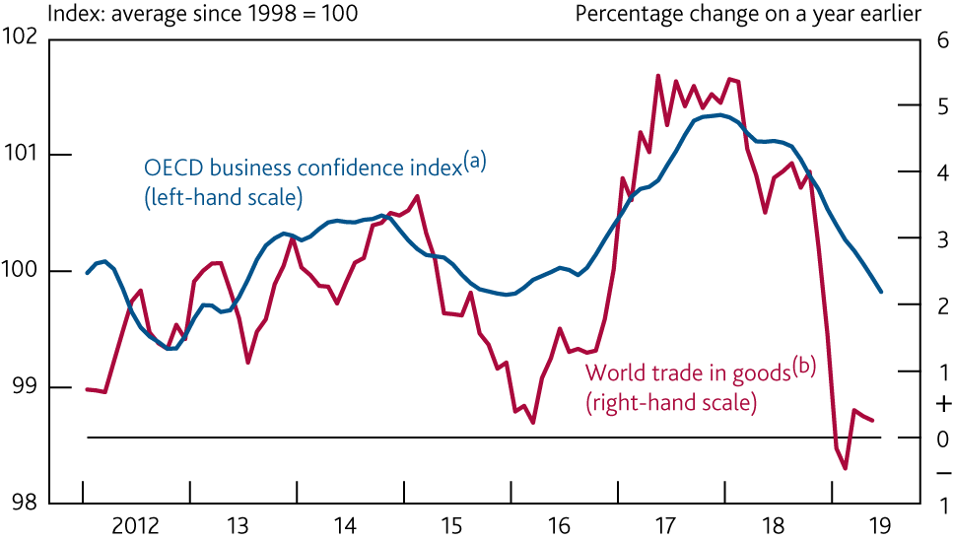
Chart 1.2 World trade in goods growth has remained weak and sentiment in the manufacturing sector has deteriorated further
World trade in goods and OECD business confidence in the manufacturing sector
Sources: CPB Netherlands Bureau for Economic Policy Analysis, OECD and Bank calculations.
(a) OECD indicator based on the arithmetic average of seasonally adjusted net balances for expected production, levels of order books and stocks of finished goods in the manufacturing sector.
(b) Three-month moving average. Volume measure.

Slide 4
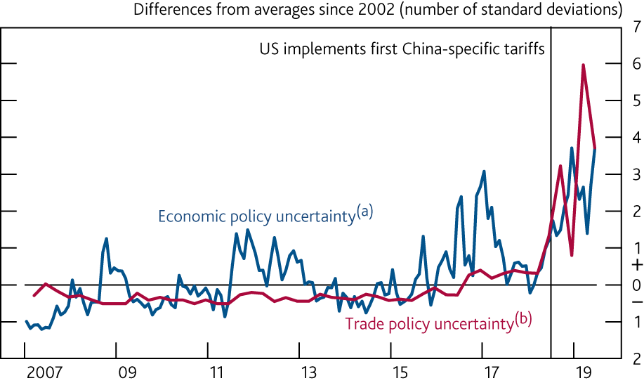
Chart 1.3 Measures of global economic policy uncertainty
remain elevated
Global economic and trade policy uncertainty
Sources: policyuncertainty.com and Bank calculations.
(a) Monthly measure of media citations of terms related to economic policy uncertainty, based on data from 20 countries. The index is weighted by PPP-adjusted GDP and together these countries account for an estimated 70% of global GDP. For details, see Baker, S R, Bloom, N and Davis, S J (2016), ‘Measuring economic policy uncertainty’, The Quarterly Journal of Economics.
(b) Quarterly measure based on the number of references to terms related to trade and uncertainty in Economist Intelligence Unit country reports. The index is equally weighted, based on data from 143 countries.

Slide 5
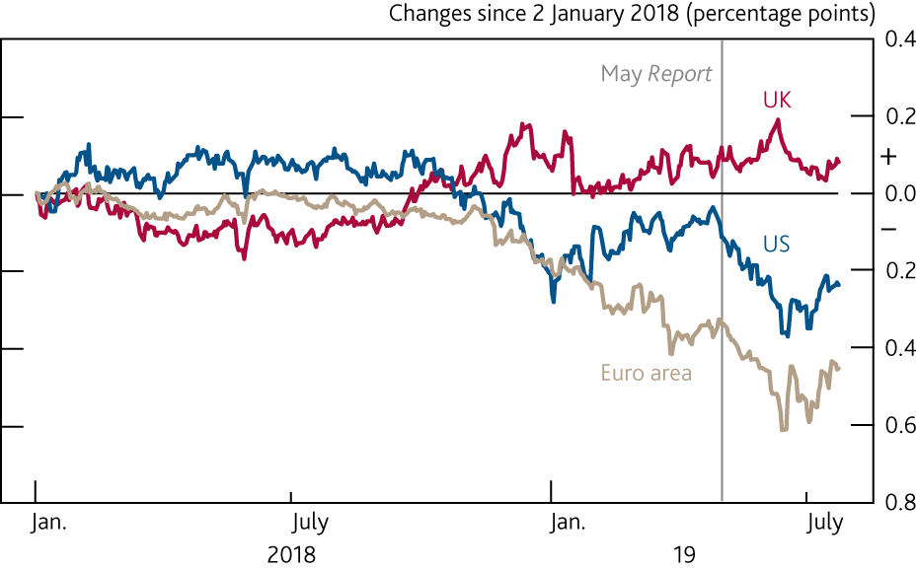
Chart 1.4 Implied inflation expectations in the US and euro area have fallen since the May Report
Changes in five-year, five-year forward inflation compensation since the start of 2018^{(a)}
Sources: Bloomberg Finance L.P. and Bank calculations.
(a) Derived from swaps. The instruments used are linked to the UK RPI, US CPI and euro-area HICP measures of inflation respectively.

Slide 6
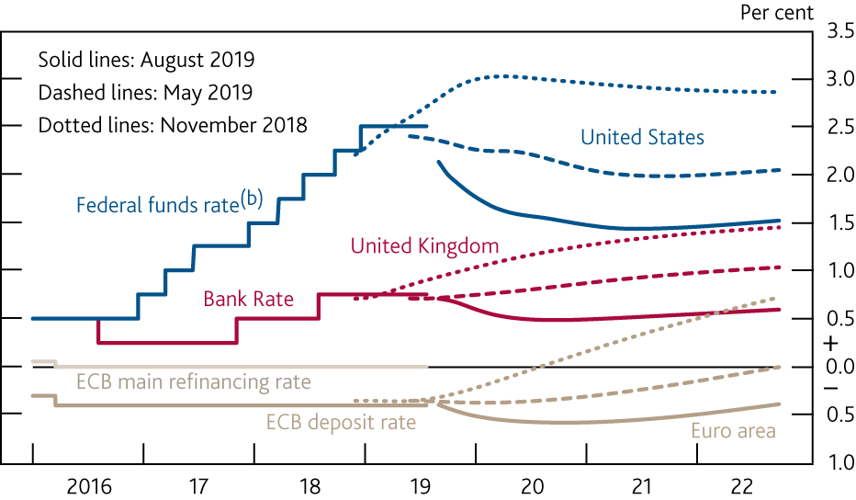
Chart 1.5 Market-implied paths for interest rates have fallen further since the May Report
International forward interest rates^{(a)}
Sources: Bloomberg Finance L.P. and Bank calculations.
(a) All data as of 24 July 2019. The August and May 2019 and November 2018 curves are estimated using instantaneous forward overnight index swap rates in the 15 working days to 24 July 2019, 24 April 2019 and 24 October 2018 respectively.
(b) Upper bound of the target range.

Slide 7
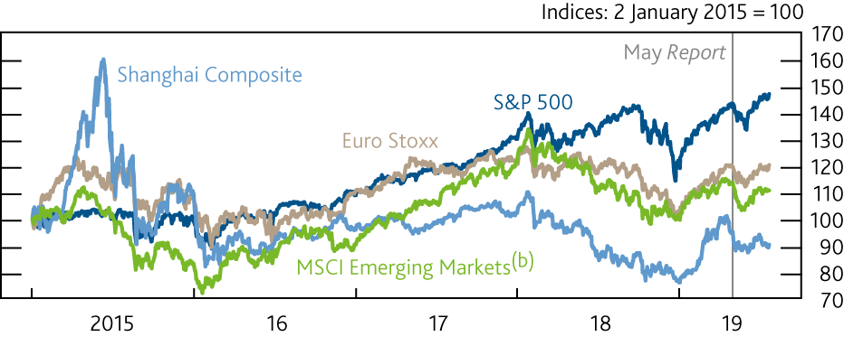
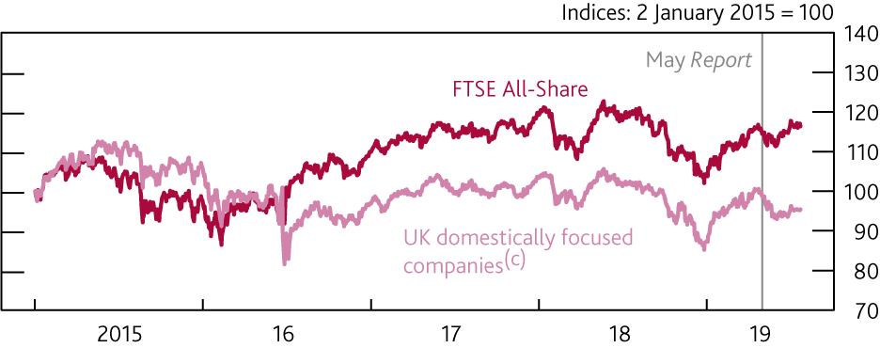
Chart 1.6 The FTSE All-Share index is broadly unchanged, but
equity prices have fallen for domestically focused UK firms
International equity prices^{(a)}
Sources: Eikon from Refinitiv, MSCI and Bank calculations.
In local currency terms, except for MSCI Emerging Markets which is in US dollar terms.
The MSCI Inc. disclaimer of liability, which applies to the data provided, is available here.
UK domestically focused companies are defined as those generating at least 70% of their revenues in the UK, based on annual financial accounts data on companies’ geographic revenue breakdown.

Slide 8
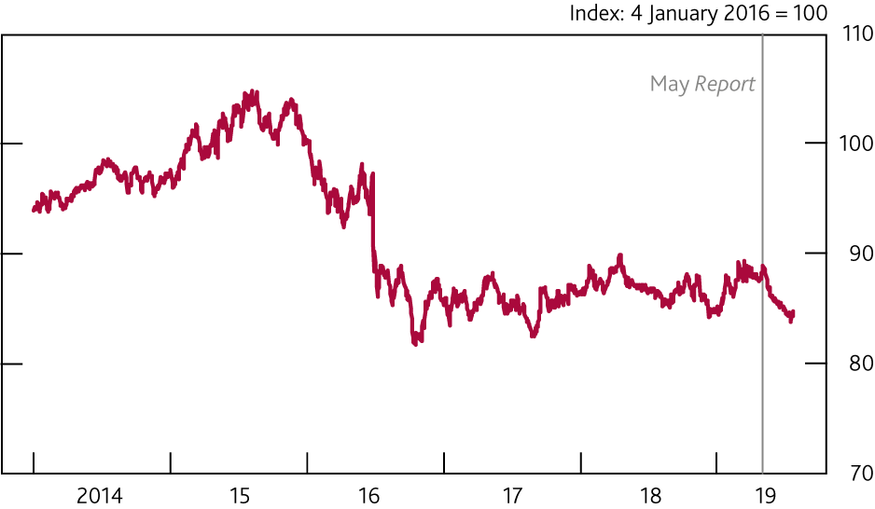
Chart 1.7 Sterling has fallen since May
Sterling ERI

Slide 9
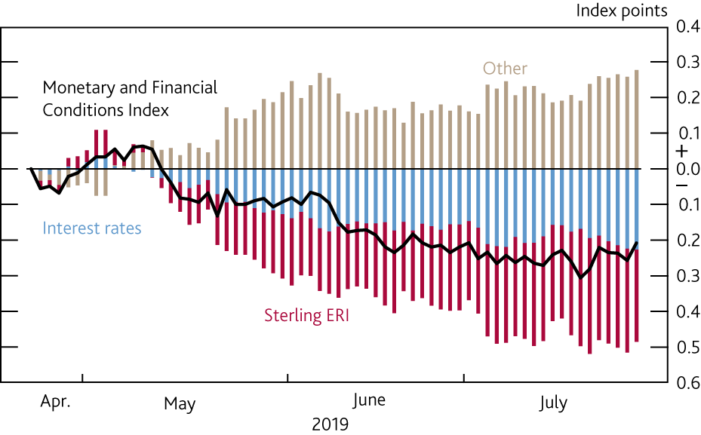
Chart 1.8 UK financial conditions have loosened since the
May Report
Contributions to changes in the UK Monetary and Financial Conditions
Index since the May 2019 Report^{(a)}
Sources: Bloomberg Finance L.P., Eikon from Refinitiv, ICE/BoAML Global Research and Bank calculations.
(a) The UK Monetary and Financial Conditions Index (MFCI) summarises information from the following series: short-term and long-term interest rates, the sterling ERI, corporate bond spreads, equity prices, and household and corporate bank lending spreads. The series weights are based on the marginal impact of each variable on the UK GDP forecast. The chart shows changes in the MFCI from the average level over the 15 working days to 24 April 2019. An increase in the MFCI signals tighter financial conditions and a decrease signals looser conditions. For more information, see the Bank Overground post ‘How can we measure UK financial conditions?’.

Slide 10
Tables

Slide 11
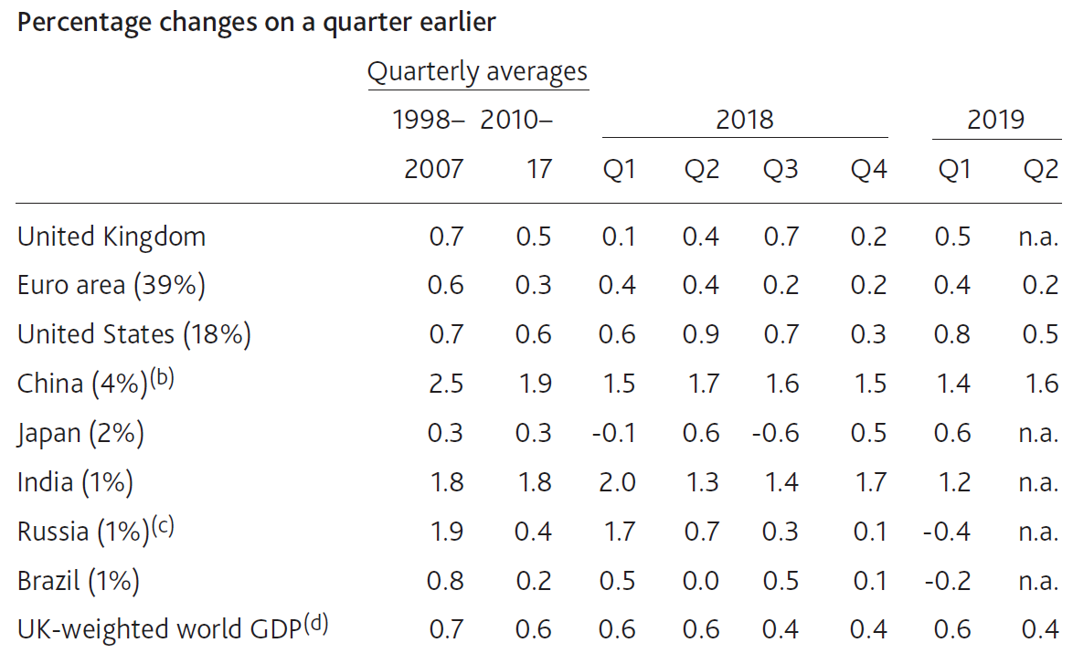
Table 1.A Global GDP growth appears to have slowed slightly in 2019 Q2
GDP in selected countries and regions^{(a)}
Sources: Eikon from Refinitiv, IMF World Economic Outlook (WEO), National Bureau of Statistics of China, OECD, ONS and Bank calculations.
Real GDP measures. Figures in parentheses are shares in UK exports in 2017.
Estimates from 2010 Q4 onwards are from the National Bureau of Statistics of China. Earlier estimates are based on OECD data.
The earliest observation for Russia is 2003 Q2.
(d) Constructed using data for real GDP growth rates for 180 countries weighted according to their shares in UK exports. Figure for 2019 Q2 is a Bank staff projection. The latest US and euro-area GDP data for 2019 Q2 have not been incorporated into this projection.

Slide 12
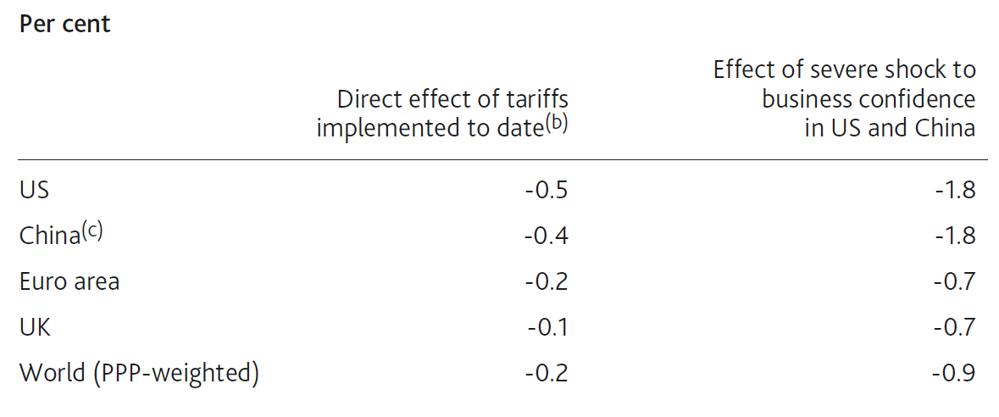
Table 1.B Trade tensions are expected to have a modest direct effect on GDP, but the indirect effects could be larger
Estimated impacts on the levels of GDP^{(a)}
Peak impacts over a three-year period.
Measures already implemented are the US tariffs on steel and aluminium, the tariffs on US$250 billion of US imports from China and those on US$110 billion of Chinese imports from the US.
The direct tariff impact on Chinese GDP is smaller than the estimate in Box 1 of the November 2018 Report, because this estimate assumes that the Chinese authorities loosen policy to offset some of the impact of higher tariffs.

Slide 13
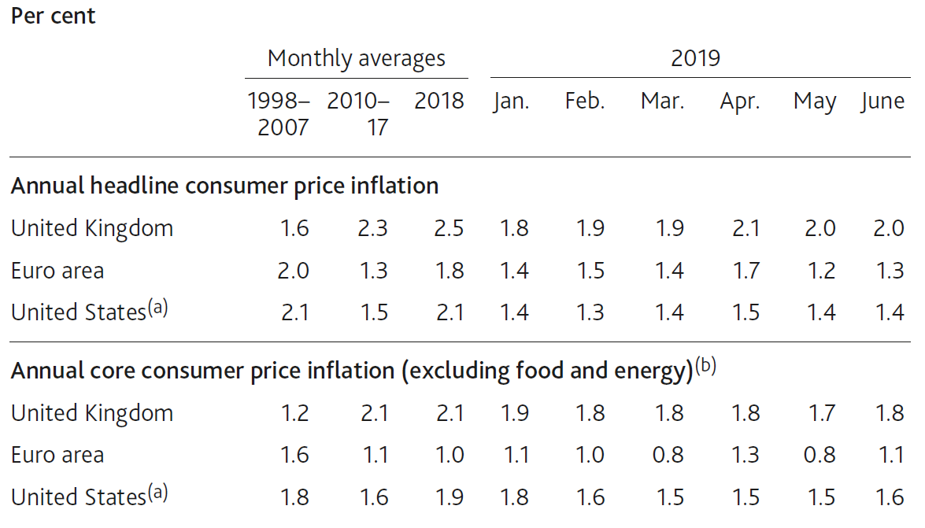
Table 1.C Inflation has been subdued in the euro area and the US
Inflation in selected economies
Sources: Eikon from Refinitiv, Eurostat, ONS, US Bureau of Economic Analysis and Bank calculations.
Personal consumption expenditure price index inflation.
For the euro area and the UK, excludes energy, food, alcoholic beverages and tobacco. For the US, excludes food and energy.

Slide 14
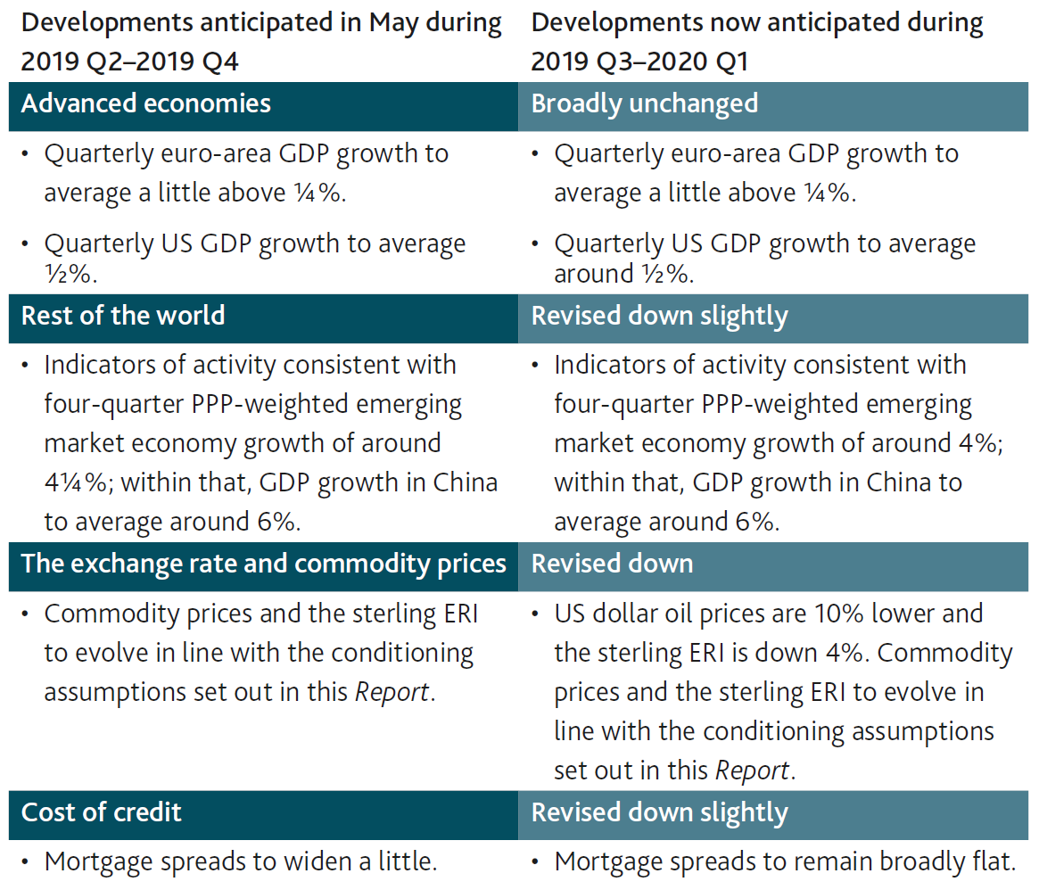
Table 1.D Monitoring the MPC’s key judgements

Slide 15
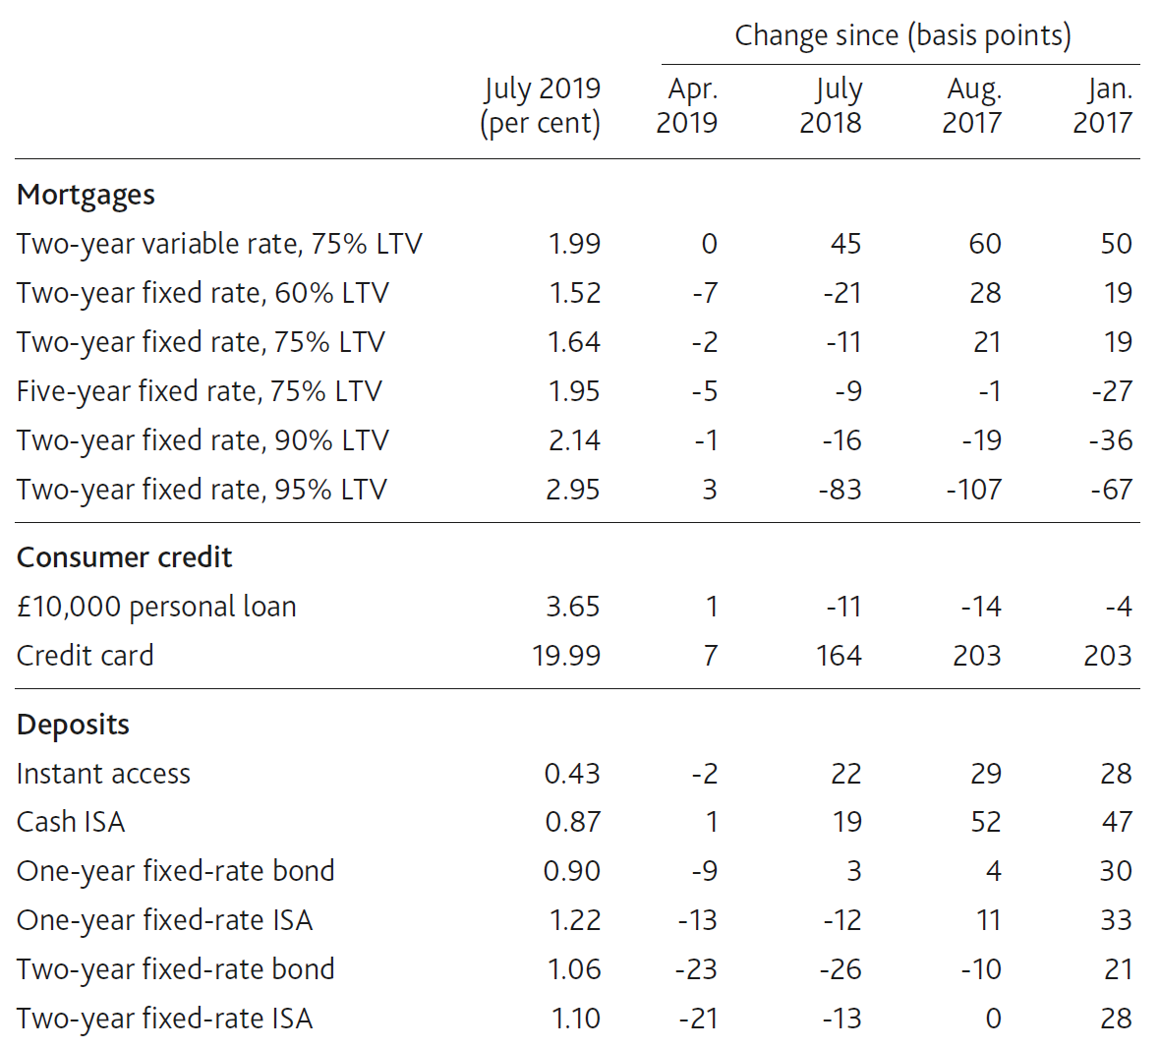
Table 1.E Retail interest rates remain low
Selected household quoted rates^{(a)}
(a) The Bank’s quoted rate series are weighted monthly average rates advertised by all UK banks and building societies with products meeting the specific criteria. Not seasonally adjusted. Data for July are flash estimates and subject to change until they are published on 7 August. In February 2019 the methodology used to calculate these data was changed. More information is available here.

